Slide 1


ANALYSING THE PERFORMANCE & EFFICIENCY OF THE RADISSON HOTELS USING DATA VISUALIZATION
KNOWLEDGE INSTITUTE OF TECHNOLOGY
DATA ANALYTICS
NM2023TMID02631
TEAM MEMBERS:
AAKASH R (611220104001)
BHUVANESWARI R (611220104024)
DEVADHARSHINI A K (611220104029)
DHANUSSH ADITYA K (611220104031)
MENTOR NAME: Mrs. M.SARANYA

Slide 2
OBJECTIVE
To Analysing “The Performance & Efficiency Of The Radisson Hotels” Using Data Visualization.

Slide 3
ABSTRACT
The hospitality industry, characterized by its competitive nature and ever-evolving customer expectations, demands a keen focus on performance and efficiency. This analysis delves into the realm of Radisson Hotels, a prominent global hotel chain, to understand the nuances that define their operational success. The primary objective is to provide a comprehensive assessment of Radisson Hotels' performance and efficiency, encompassing financial stability, operational processes, and customer satisfaction. This project employs a multifaceted approach, amalgamating quantitative and qualitative data. It involves an in-depth exploration of key performance indicators (KPIs) like occupancy rates, revenue per available room, and guest satisfaction scores. Financial data analysis unveils insights into the company's fiscal health, while scrutinizing operational processes such as inventory management, staff productivity, and sustainability practices offers a holistic view. Customer feedback, obtained through surveys and sentiment analysis tools, further enriches the perspective.

Slide 4
PROBLEM STATEMENT
The hotel industry encompasses a wide array of lodging businesses, from opulent resorts to budget-friendly motels, catering to travellers worldwide. These establishments play a vital role in the tourism and travel sector. Radisson, a longstanding player in the hospitality industry with a century of experience, currently faces challenges in losing market share and revenue in the luxury and business hotel segment due to competitive pressures and managerial shortcomings. To counter this, Radisson's managing director aims to integrate Business and Data Intelligence for improved decision-making. Our mission is to develop an analytics dashboard and narrative that delivers valuable insights to guide enhanced business strategies.

Slide 5
SOLUTION
The solution involves conducting a detailed analysis by evaluating financial data, key performance indicators, operational processes, and customer feedback. This holistic approach will provide Radisson Hotels with actionable insights to optimize their operations, leading to improved efficiency and enhanced guest satisfaction, ultimately positioning the chain for long-term success.
What sets this analysis apart is its comprehensive approach. It combines financial, operational, and customer-centric perspectives, offering a holistic view of Radisson Hotels' performance. This unique method allows for a thorough understanding of strengths and weaknesses, enabling data-driven decision-making and industry-wide insights.

Slide 6
Customer satisfaction is a critical aspect of the analysis. It involves collecting and analyzing guest feedback, ensuring that Radisson Hotels' performance and efficiency assessments incorporate the customer perspective. By understanding and addressing customer needs and preferences, the project aims to enhance overall guest experiences and, subsequently, the hotel chain's success.
The business model for analyzing Radisson Hotels' performance and efficiency involves a multidimensional approach, combining data collection, analysis, and actionable recommendations. It aims to improve operational processes and enhance customer experiences, ultimately increasing profitability and market competitiveness. The model focuses on data-driven decision-making to drive positive outcomes for both the hotel chain and the industry as a whole.
The solution's scalability is inherent in its methodology, making it adaptable to hotels of varying sizes and locations. Whether it's a single hotel or a global chain like Radisson, the comprehensive analysis framework can be applied universally, allowing for tailored insights and improvements, regardless of the scale of operations.

Slide 7
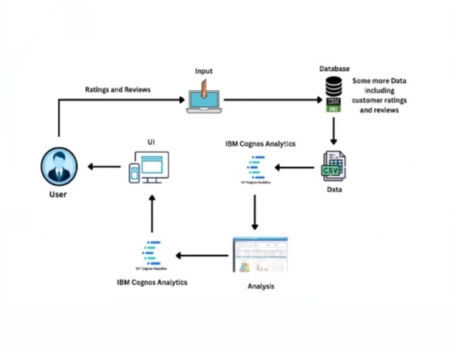
SOLUTION ARCHITECTURE

Slide 8
TOOLS USED
HARDWARE REQUIREMENTS
Processor : Intel Core i3
RAM : 8 GB
Hard disk : 500 GB
SOFTWARE REQUIREMENTS
Operating System : Windows
Language : HTML, CSS, JavaScript, Python
Web Framework : Flask
TOOL REQUIREMENTS
Operating System : Window 10
Disk Space : 256 MB
Processor : Intel atom processor
Version : 3.6.2

Slide 9
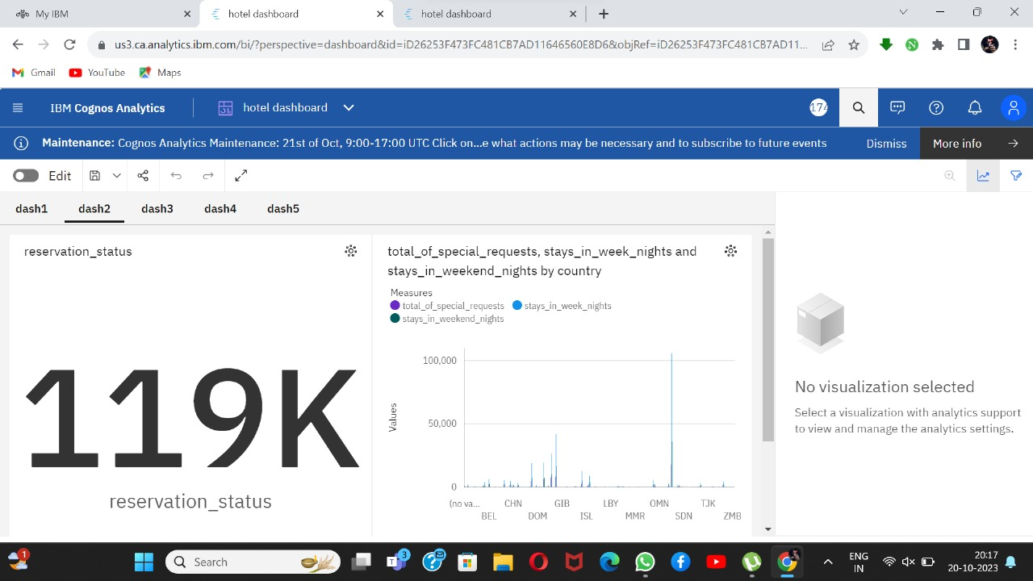
DASHBOARD

Slide 10
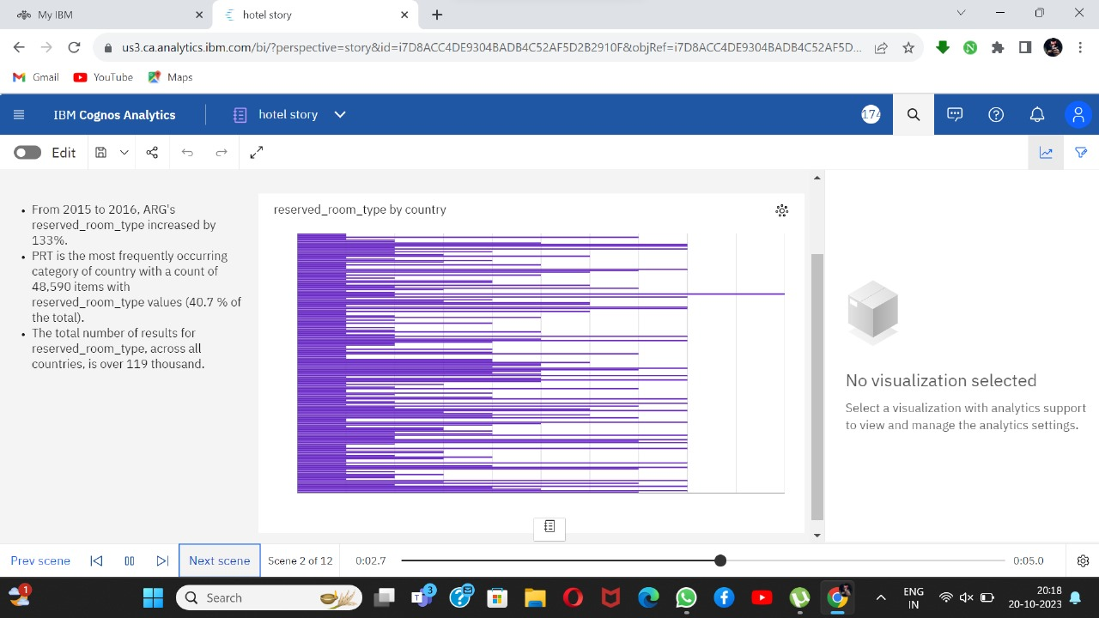
STORY

Slide 11
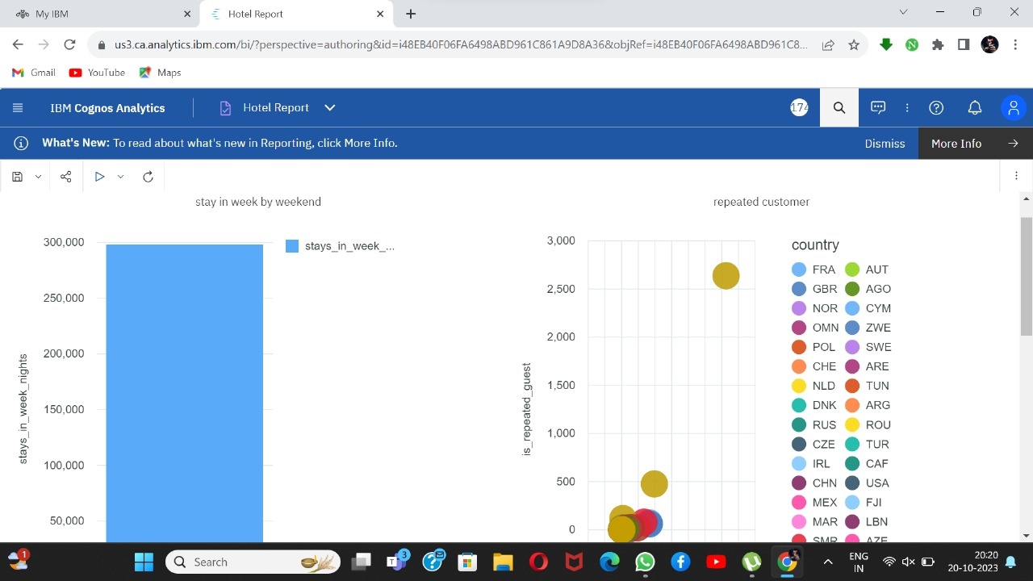
REPORT

Slide 12
THANK YOU…!

